Slide 1
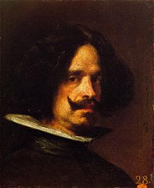
Diego Velazquez
By Marcus Stevens

Slide 2
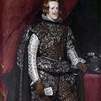
Portrait Philip IV in Brown and Silver -

